Slide 1
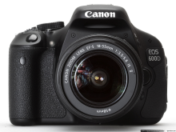
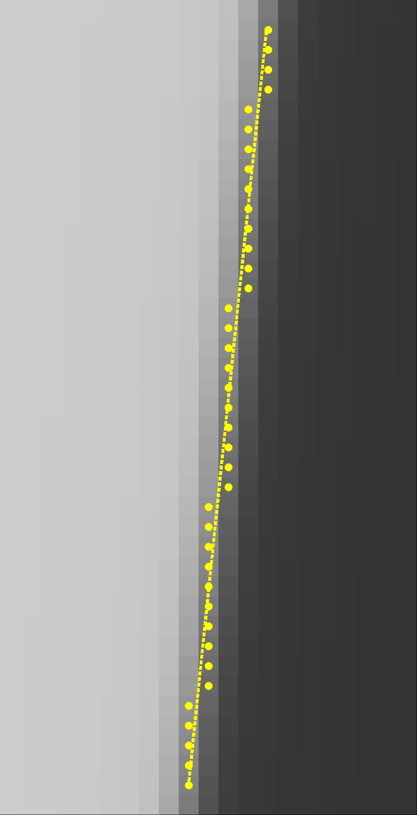
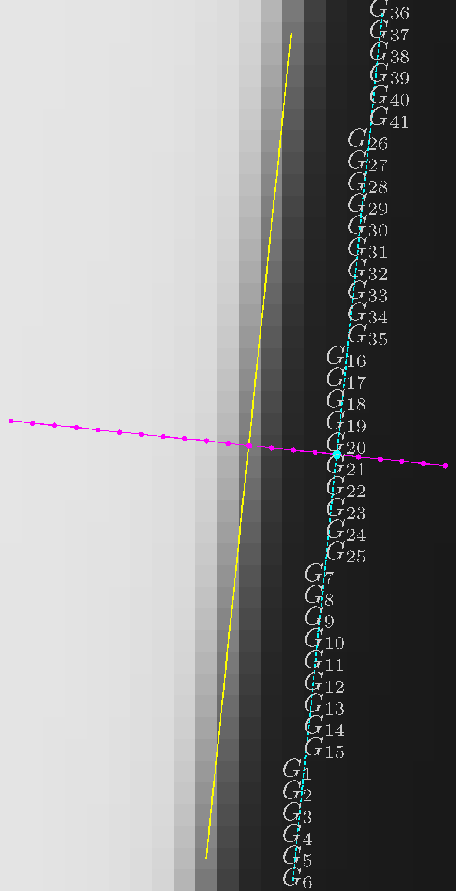
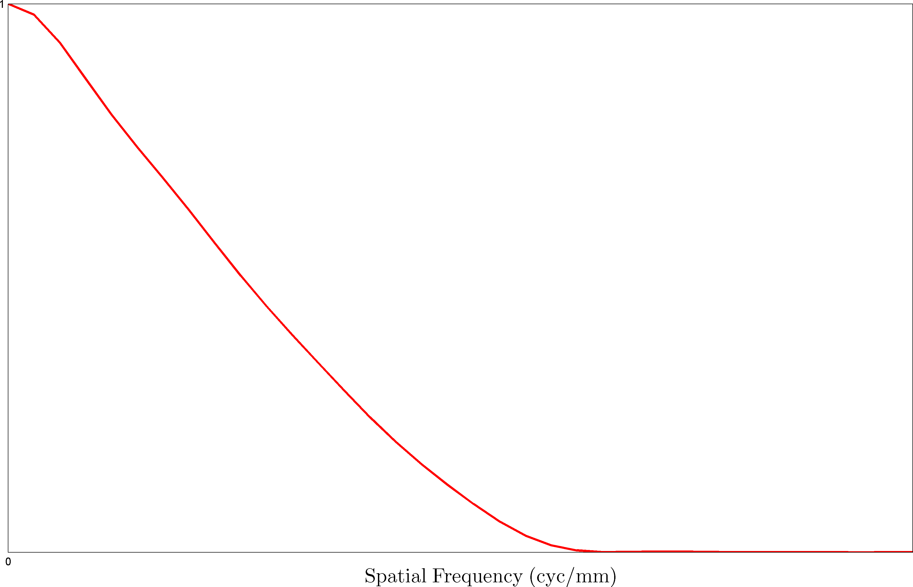
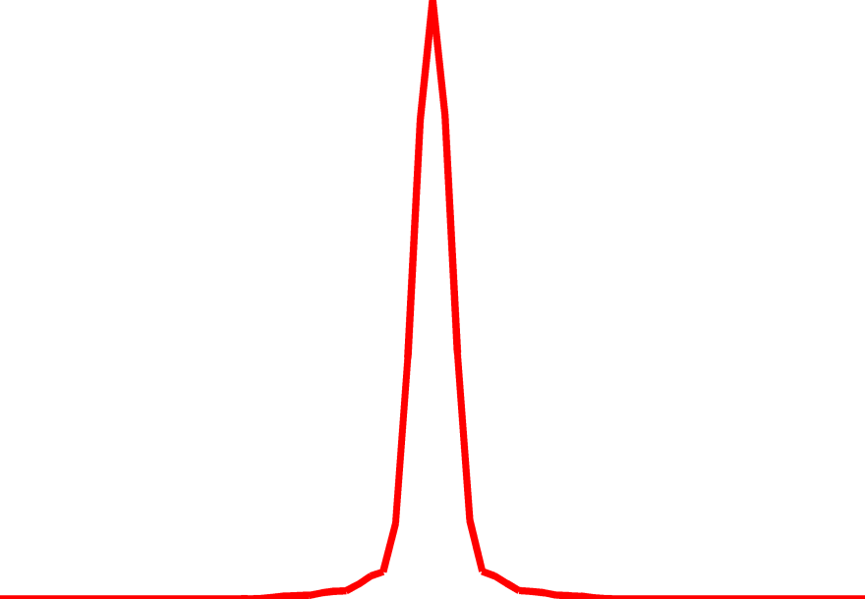
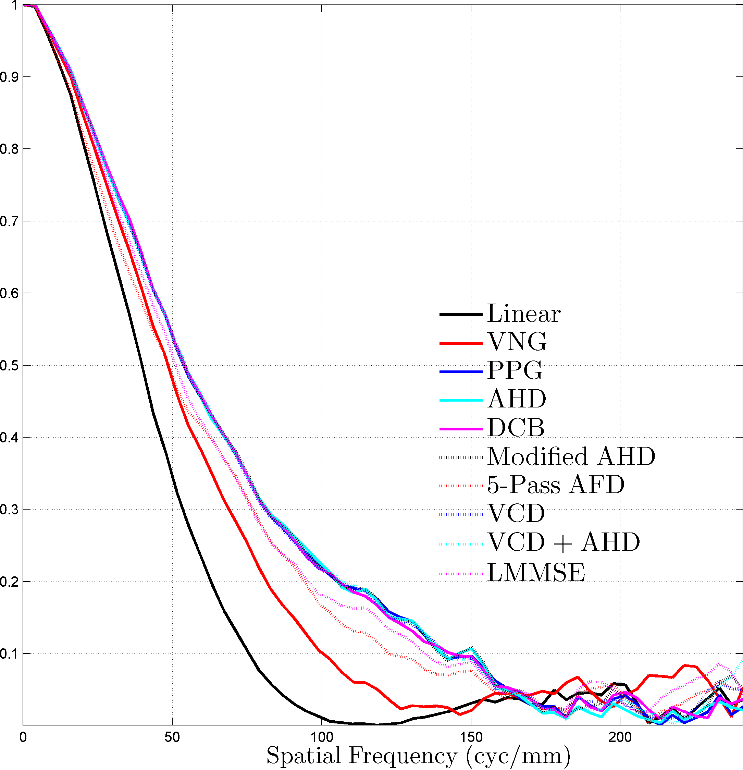
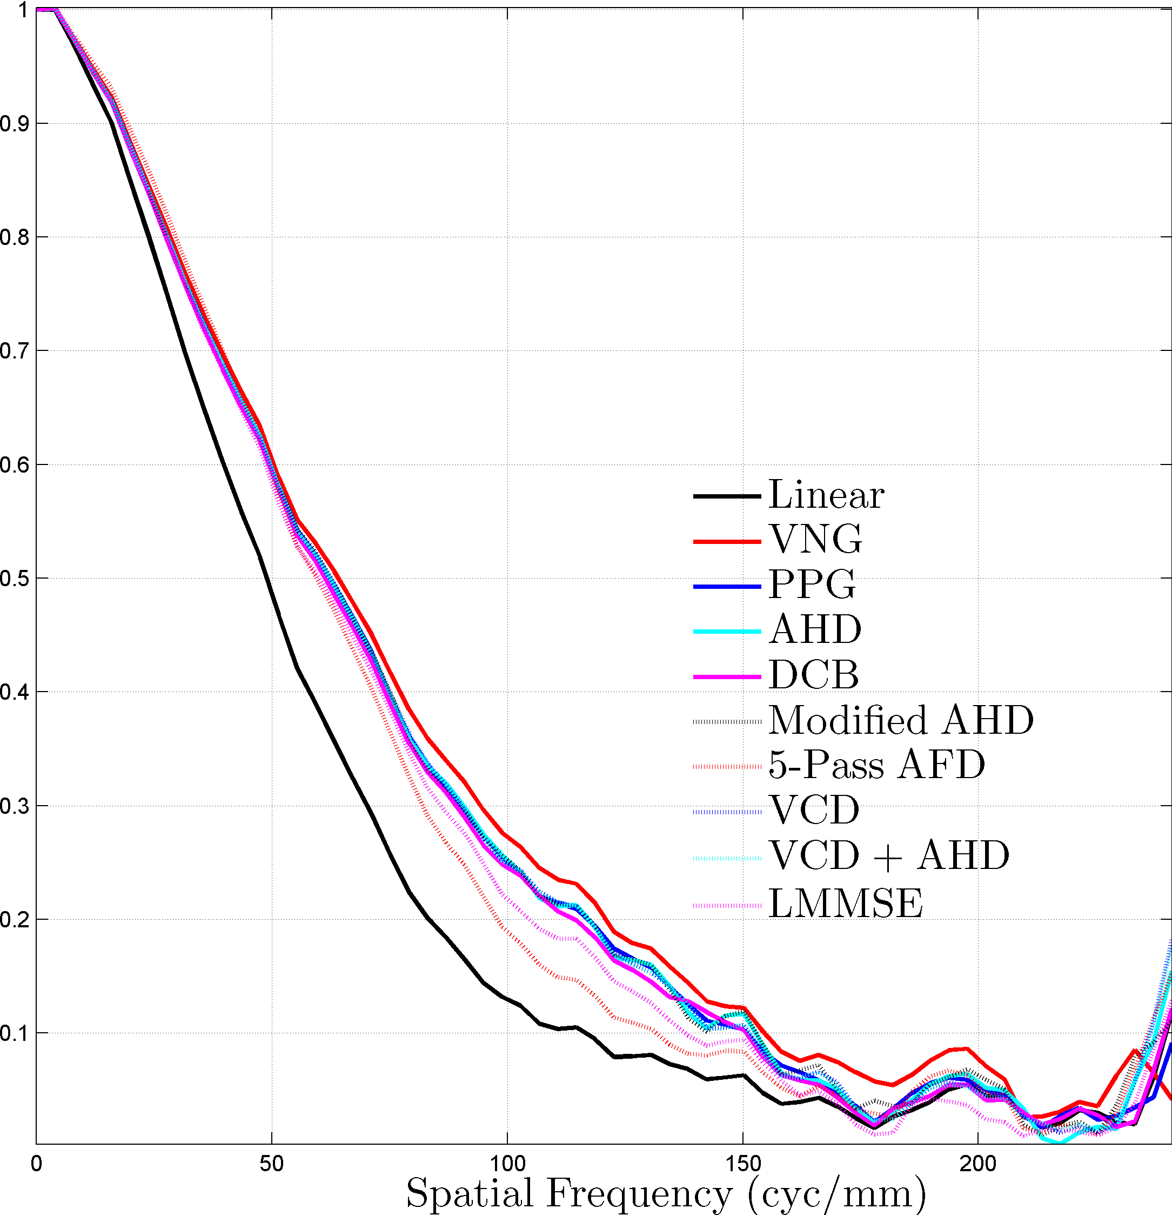
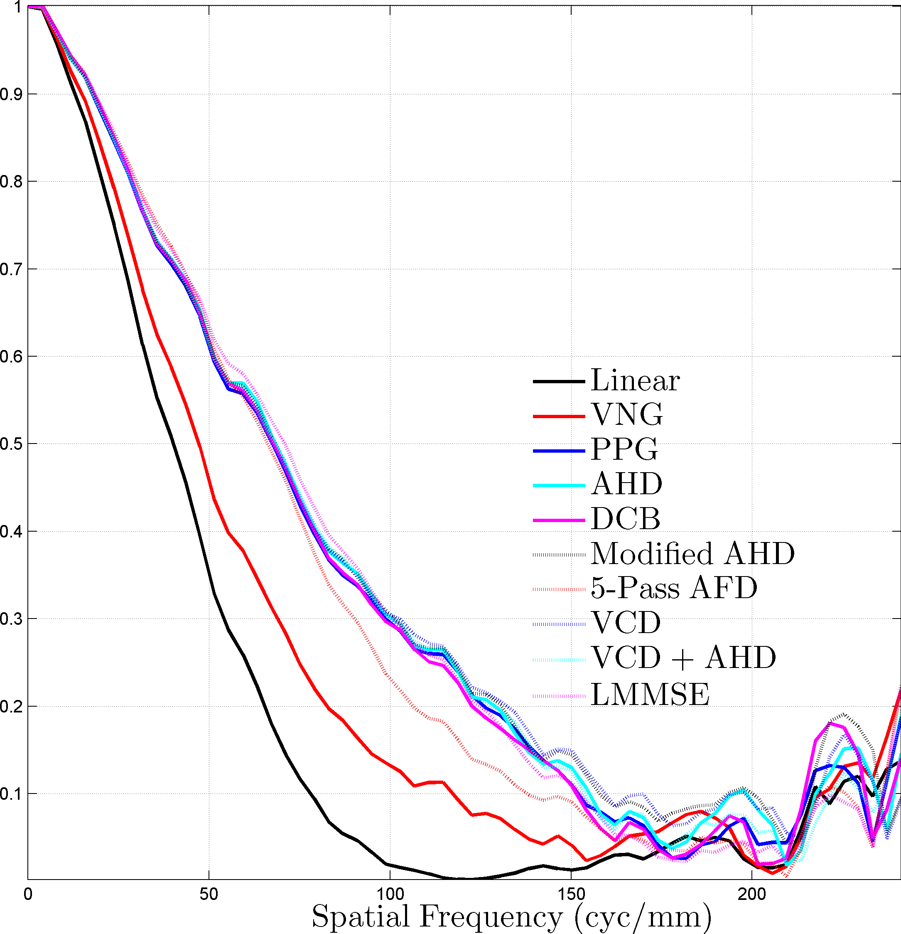
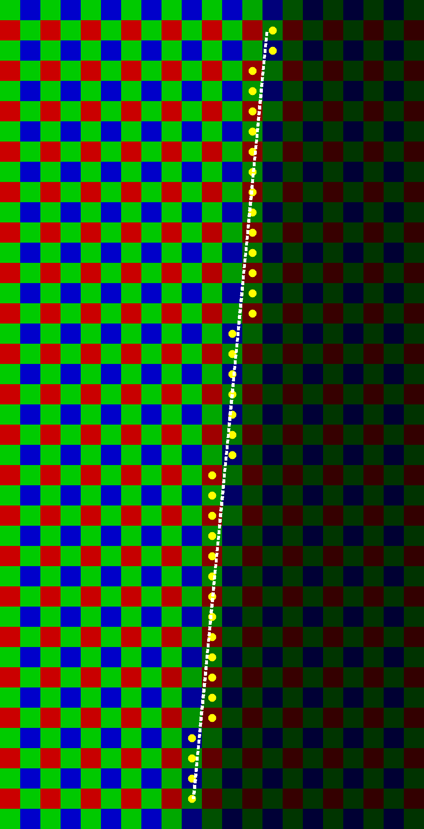
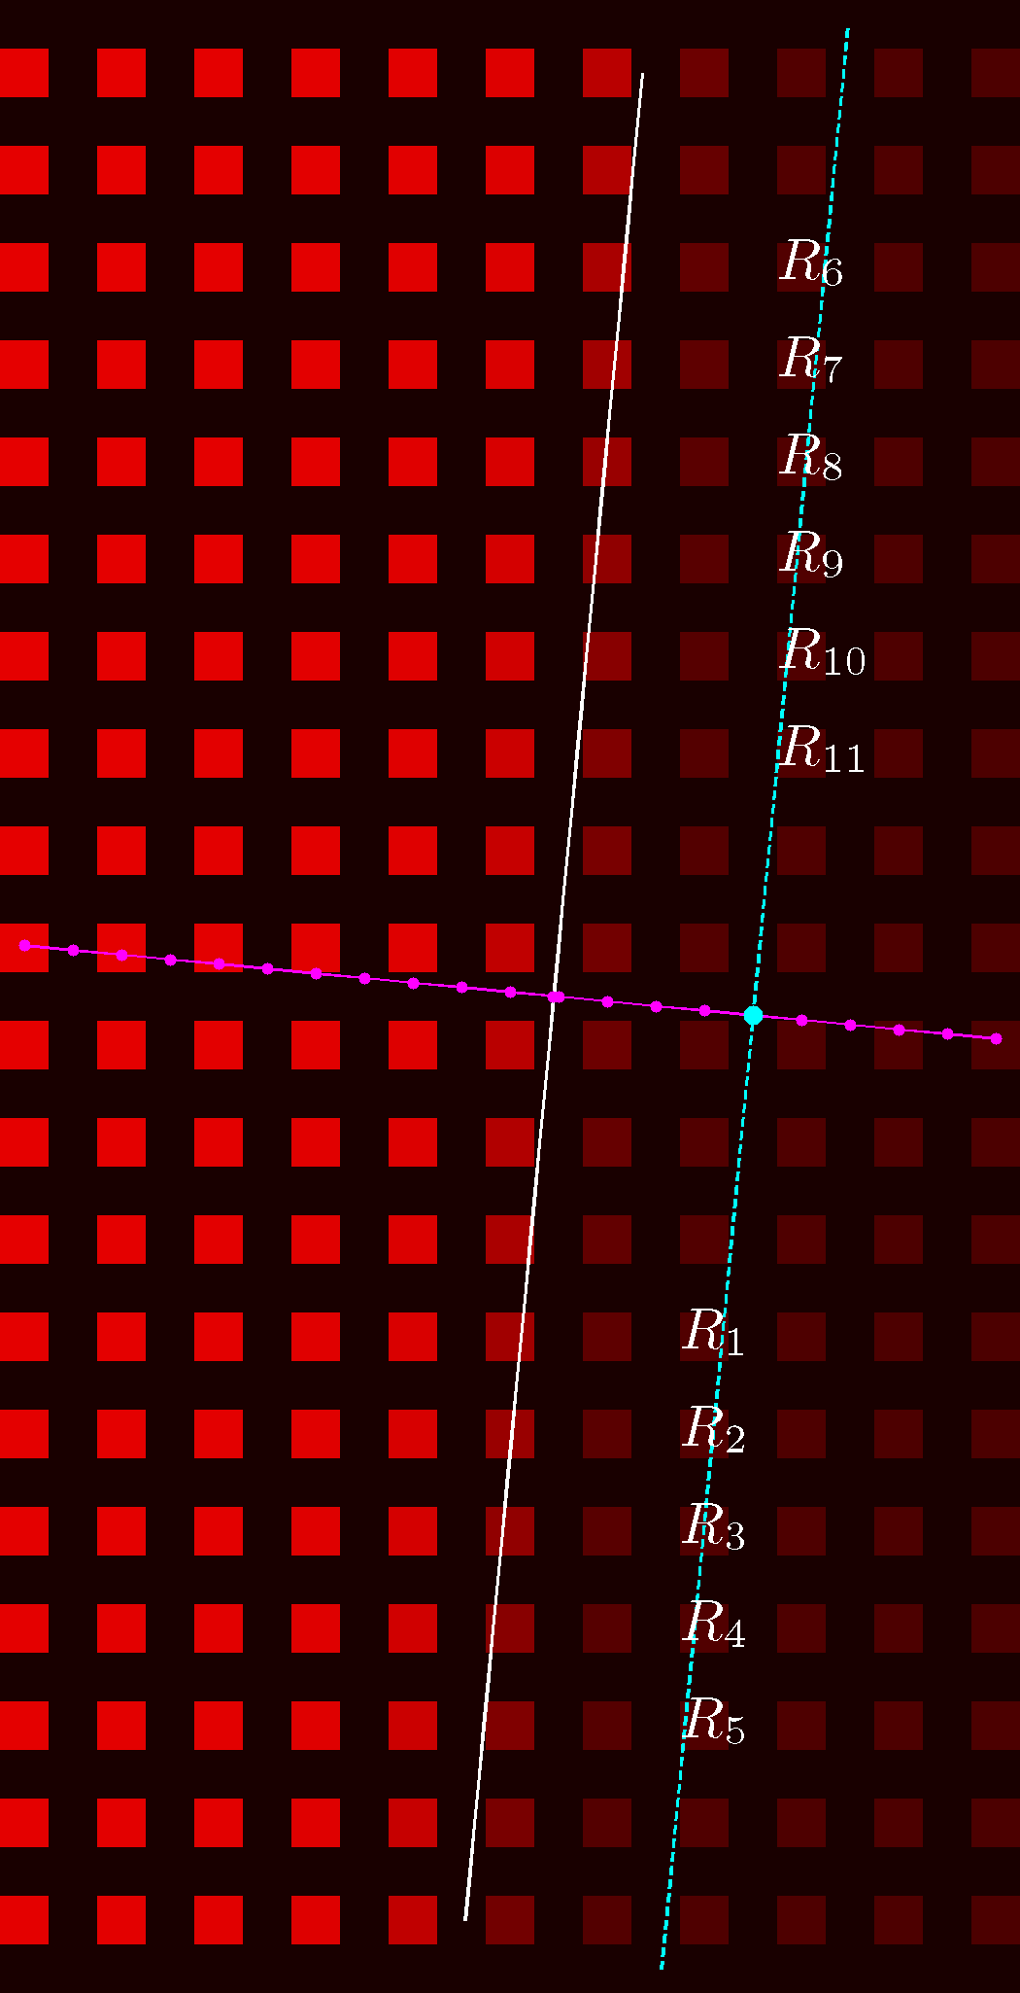
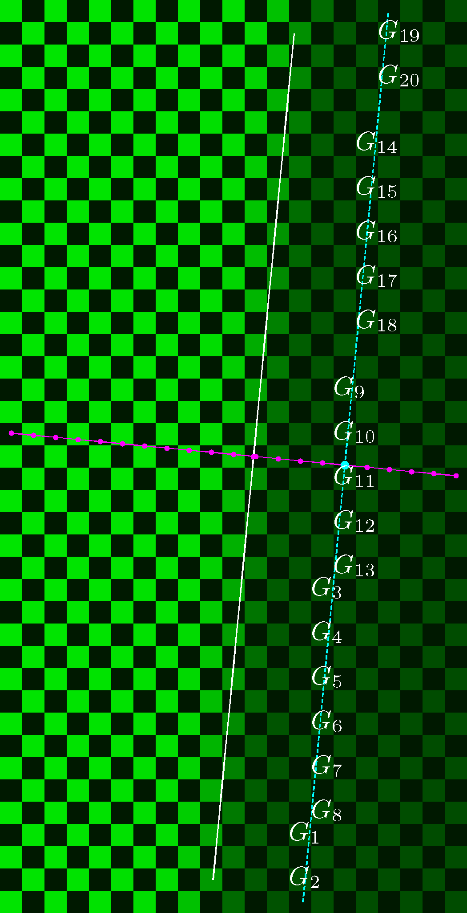
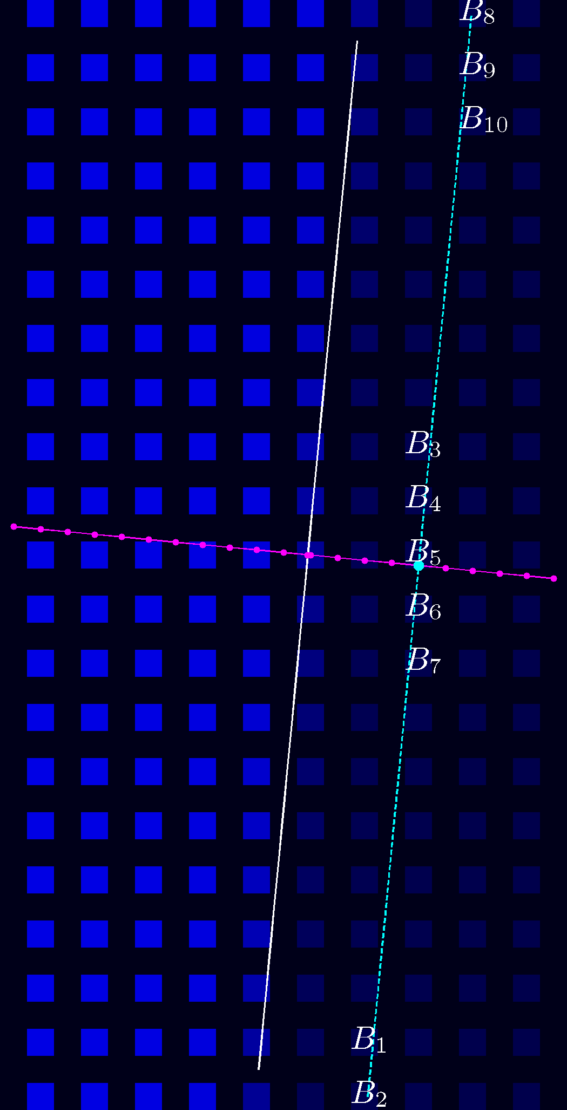
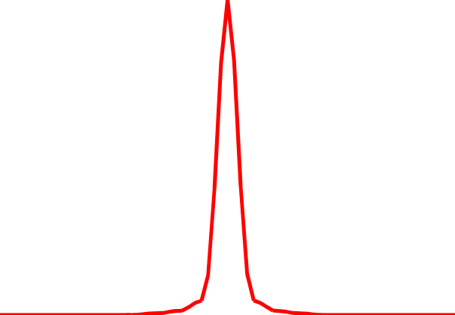
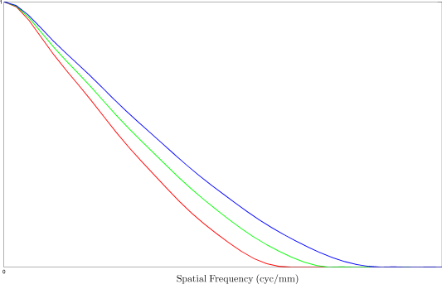
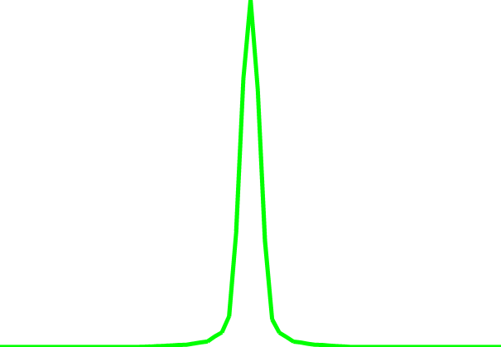
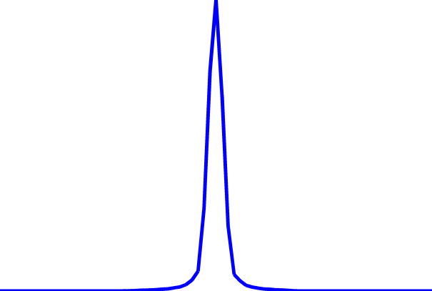
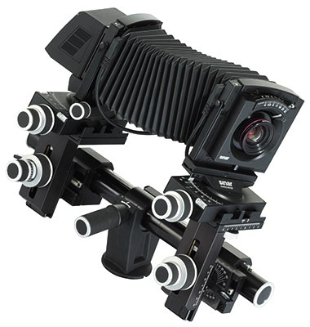
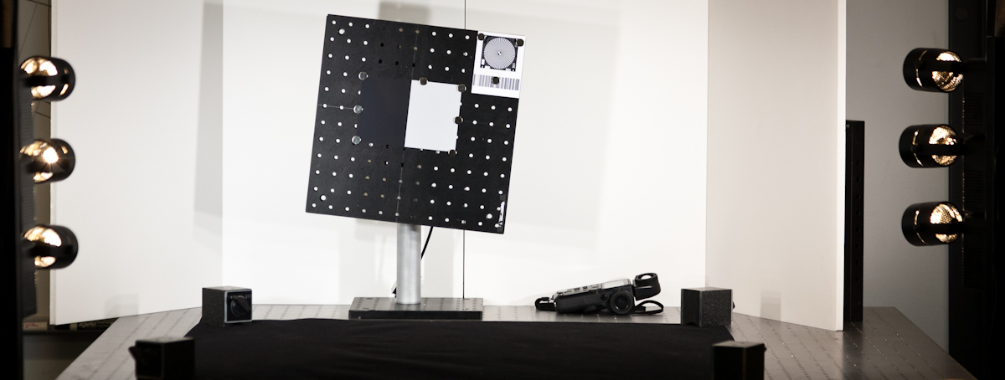
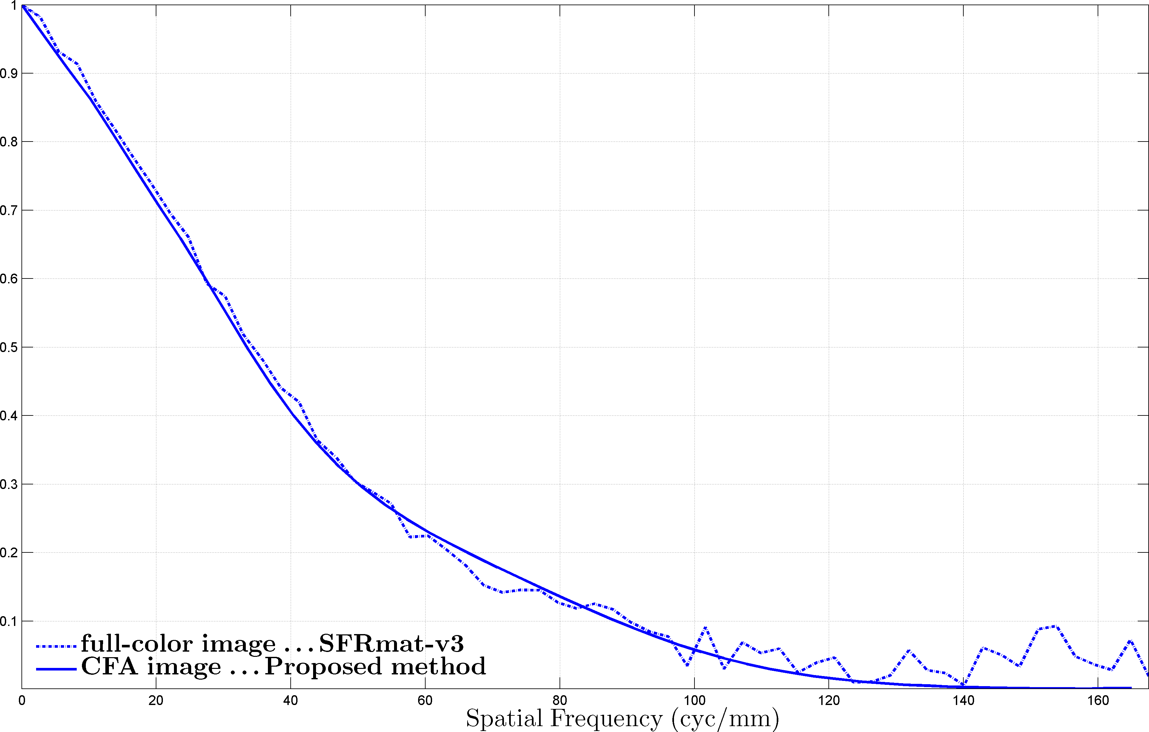
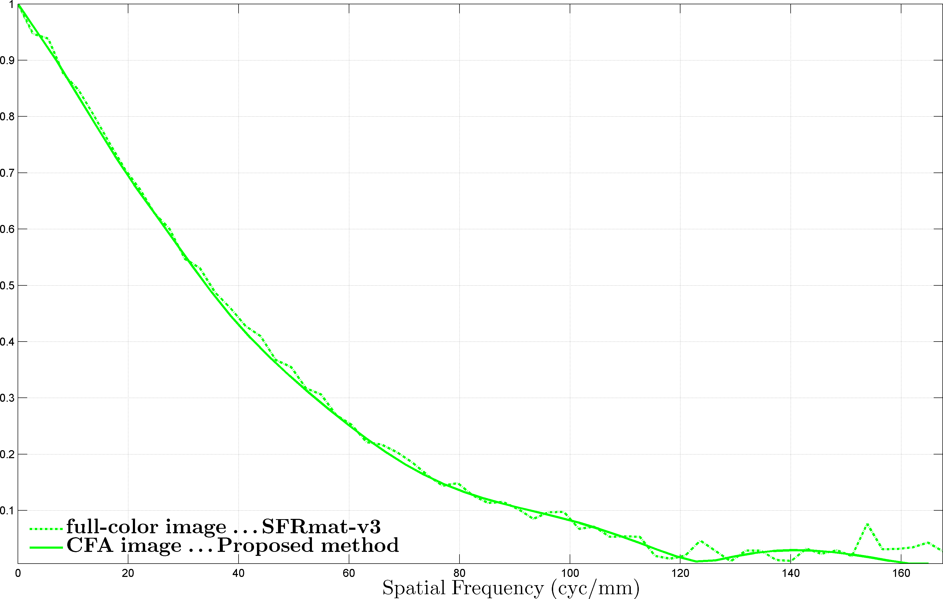
A critical review of the Slanted Edge method for MTF measurement of color cameras
Prasanna Rangarajan | Indranil Sinharoy | Dr. Marc P. Christensen | Dr. Predrag Mlojkovic
prangara@smu.edu | isinharoy@smu.edu | mpc@lyle.smu.edu | predrag.milojkovic.civ@mail.mil
Sponsored by United States Army Research Laboratory
$$s(x,y)$$
$$s\left(x,y\right)⊗h(x,y)$$
What is the Spatial Frequency Response ?
The “Spatial Frequency Response” of an imaging system defines its ability to capture/maintain the relative radiometric contrast of increasingly fine sinusoidal patterns
The SFR/MTF describes the variation in the amplitude response $|H\left(ξ,η\right)|$of the imaging system as a function of spatial frequency
It depends on the optics, pixel geometry & fill-factor, and the severity of optical low-pass filtering
Significance
It is an important performance metric that quantifies resolution & the severity of aliasing
How does one measure the SFR ?
Using periodic test patterns that span a discrete set of frequencies
(Impulse Response)Fourier Transform of the Point Spread Function $h\left(x,y\right)→$ take a picture of a point source
Power Spectrum of stochastic targets with known power spectra
(Step response) Fourier Transform of the derivative of Edge Spread Function $→t$ake a picture of a reflectance edge
Point Spread Function
$$h(x,y)$$
$$H(ξ,η)$$
Optical Transfer Function
$$S(ξ,η)$$
$$S\left(ξ,η\right)H\left(ξ,η\right)$$
SFR Estimation using the Slanted Edge Method ( ISO12233 standard ) SFRmat, MITRE-SFR (open-source)
Camera image of Slanted Edge
Identify slope & intercept of edge by LS line fitting
Identify super-sampled Edge Spread Function
NOTE: The slanted edge method outlined in the ISO12233 standard is only concerned with the SFR of the luminance channel.
$\frac{∂}{∂n}\left(…\right)$
$$ℱ\{…\}$$
Spatial Frequency Response
Super-sampled
Edge Spread Function
Derivative
filtering
Super-sampled
Line Spread Function
DFT
Existing method for identifying the SFR of digital cameras with color filter arrays IMATEST, DXO Analyzer, iQ-Analyzer, Quick-MTF
Slanted Edge Target
Color Filter Array Image
Interpolated Full-Color Image
Canon EOS 600D
18-55 mm, F3.5-5.6 IS kit lens
18mm, F5.6, ISO 100
Sensor Nyquist $=119.9 lp/mm$
Blue Nyquist $=59.95 lp/mm$
Canon EOS 600D
18-55 mm, F3.5-5.6 IS kit lens
18mm, F5.6, ISO 100
Sensor Nyquist $=119.9 lp/mm$
Green Nyquist $=84.79 lp/mm$
Canon EOS 600D
18-55 mm, F3.5-5.6 IS kit lens
18mm, F5.6, ISO 100
Sensor Nyquist $=119.9 lp/mm$
Red Nyquist $=59.95 lp/mm$
Demosaicing
Slanted Edge
SFR Estimation
Proposed method for identifying the SFR of digital cameras with color filter arrays download at http://lyle.smu.edu/~prangara/CFASFR/
CFA image of Slanted Edge
Identify slope & intercept of edge by LS line fitting
Identify super-sampled Edge Spread Function for each color channel
$\frac{∂}{∂n}\left(…\right)$
$$ℱ\{…\}$$
Spatial Frequency Response
Derivative
filtering
Super-sampled
Line Spread Function
DFT
Experimental Validation Full-color SFR estimation (SFRmat-v3) vs. Color Filter Array SFR estimation (Proposed Method)
$$6^{°}$$
Sensor Nyquist $=83.33 lp/mm$
Blue Nyquist $=41.67 lp/mm$
Sensor Nyquist $=83.33 lp/mm$
Green Nyquist $=58.93 lp/mm$
4700K
Solux Lamps
Full-color SFR estimation (SFRmat-v3 )
Input: 3-channel RGB image captured by the camera
CFA SFR estimation (Proposed method)
Input: synthetically generated CFA image obtained by subsampling 3-channel RGB image
CFA pattern used in experiment G R
B G
Sinar P3 with 86H back: 48.8-MP
180mm,F/5.6 HR Rodenstock lens
Pixel pitch $=6.0 μm$
Aperture Setting = F/11, ISO 50
captures RGB information at every pixel in 4-shot mode
Technical reference
P. Rangarajan, I. Sinharoy, M. P. Christensen, and P. Milojkovic, “A critical review of the slanted-edge method for color SFR measurement“, OSA Topical meeting on Imaging Systems & Applications, 2012
Acknowledgement
We wish to thank Dr. Peter Burns (developer of SFRmat) for his valuable comments & insights.

