Slide 1
EMP Case Study: Capturing Infrastructure interdependencies
Southern Methodist University
Management Science Senior Design Team:
Stephen Beckert
Brandon Joslin
Pierce Meier
Lockheed Martin Project Team:
Dr. William P. Nanry, Project Lead
Christopher Askew, Technical Lead
Missiles and Fire Control -- Dallas

Slide 2
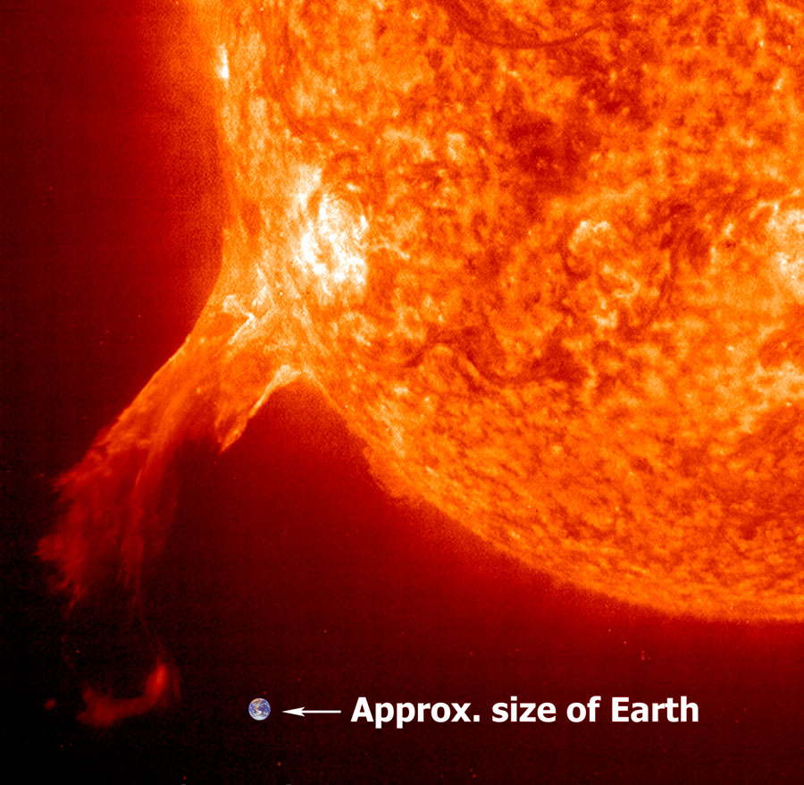
What is EMP?
Electromagnetic Pulse (EMP) is a burst of electromagnetic energy that creates fluctuating electric and magnetic fields
EMP is absorbed on contact by metallic surfaces
Two Types of EMP Events:
Natural (Solar Flares)
Nuclear Attack

Slide 3
What is EMP?
Nuclear EMP has 3 composite waveforms:
E1: fastest pulse (nanoseconds) and shortest waveform
- Produces intense electric field that quickly induces high voltages in conductors
- Too fast a pulse for surge protectors to defend against
E2: fast pulse (hundredths to tenths of seconds)
- Produces electromagnetic pulses and waveforms very similar to lightning
E3: very slow pulse (tens to hundreds of seconds)
- Produces large Geomagnetically Induced Currents (GIC) that can damage large electrical components

Slide 4
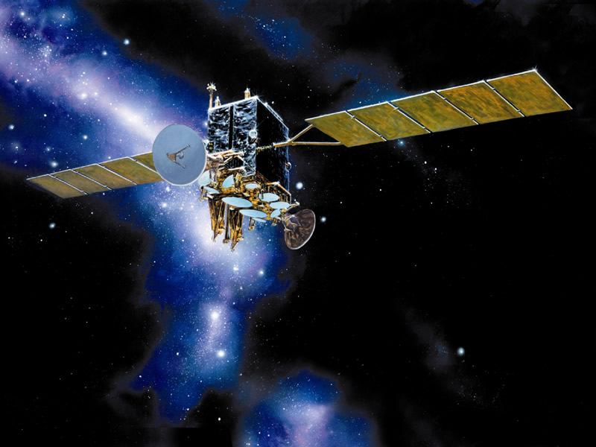
EMP Effects are Dependent on the Size of the Conductors Present
Large Contact Surfaces: Permanent Damage
AC Power Lines
Telecommunication Lines
Electric Grid Transformers
Space Stations and Satellites
Small Contact Surfaces: Possible Minor Damage
Laptops
Cell Phones
Household Appliances

Slide 5
Types of Attacks
Scale | Vignette | Adversary | Location | Type of Device | HOB | Yield | Delivery
National | 4 | Peer/near-peer Competitor | Heartland | Thermonuclear | 300 km | 300kT | Satellite
Local | 8 | Criminal element | Wall Street | Non-nuclear EMP | Ground-level | - | Van
Regional | 7 | Rogue nation supporting a terrorist organization | NE Corridor | Fission | 40 km | 40kT | -
Natural attacks are also possible, and would generate effects
similar to a National Nuclear attack

Slide 6
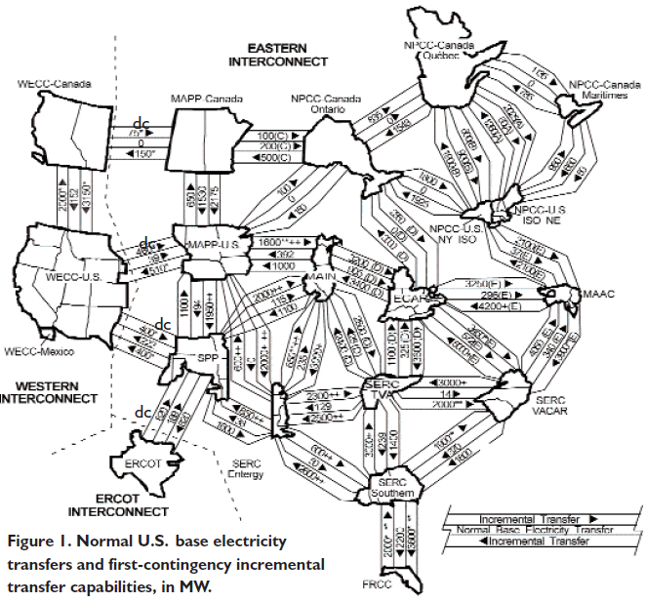
Interconnectivity of U.S. Power Grid
Power Infrastructure could potentially collapse following sufficiently robust EMP attack
Notes:
N-1 Grid in the Eastern Coast (that we know of). It can accept the failure of one area, but not two or more.
The US power grid is composed of just 3 regulatory regions
The Eastern Interconnect supplies 70% of US population, and is by far the most complex region
The Texas interconnect has passed legislation that will enable itself to “island” in the time of a crisis
Electric power system is the largest single capital-intensive infrastructure in North America
Generation and transmission of power in the US is NOT monopolized
There are over 1400 power companies in the CONUS making effective regulation very difficult
What’s Wrong with the Electric Grid?, Eric J. Lerner, The Industrial Physicist, OCTOBER/NOVEMBER 2003, pg 8
Electrical Power – Background
The electrical power system is the largest single capital-intensive infrastructure in North America
Vast network is broken into just three separate regulatory regions
Western Interconnection
Eastern Interconnection (Serves 70% of the population of the U.S.)
Texas (ERCOT)
Transformers are the critical link between generation, transmission, and distribution
Electrical Power – Vulnerability to EMP
The Commission separately analyzed the potential effects of EMP on the three main constituents of the power system – generation, transmission, and distribution
They found that recovery following an EMP-caused outage is contingent largely on preventing damage to high-value assets (i.e. large transformers) and repairing/ replacing those that are damaged
Proper design, installation, and functioning of protective equipment for these assets during an EMP attack are critical
Lack of information and communication post-attack, as well as the concurrent impacts on other infrastructures further impede recovery¹⁸ [18. Report of the Commission To Assess the Threat to the United States From an Electromagnetic (EMP) Attack, Critical National Infrastructures, April 2008.]

Slide 7
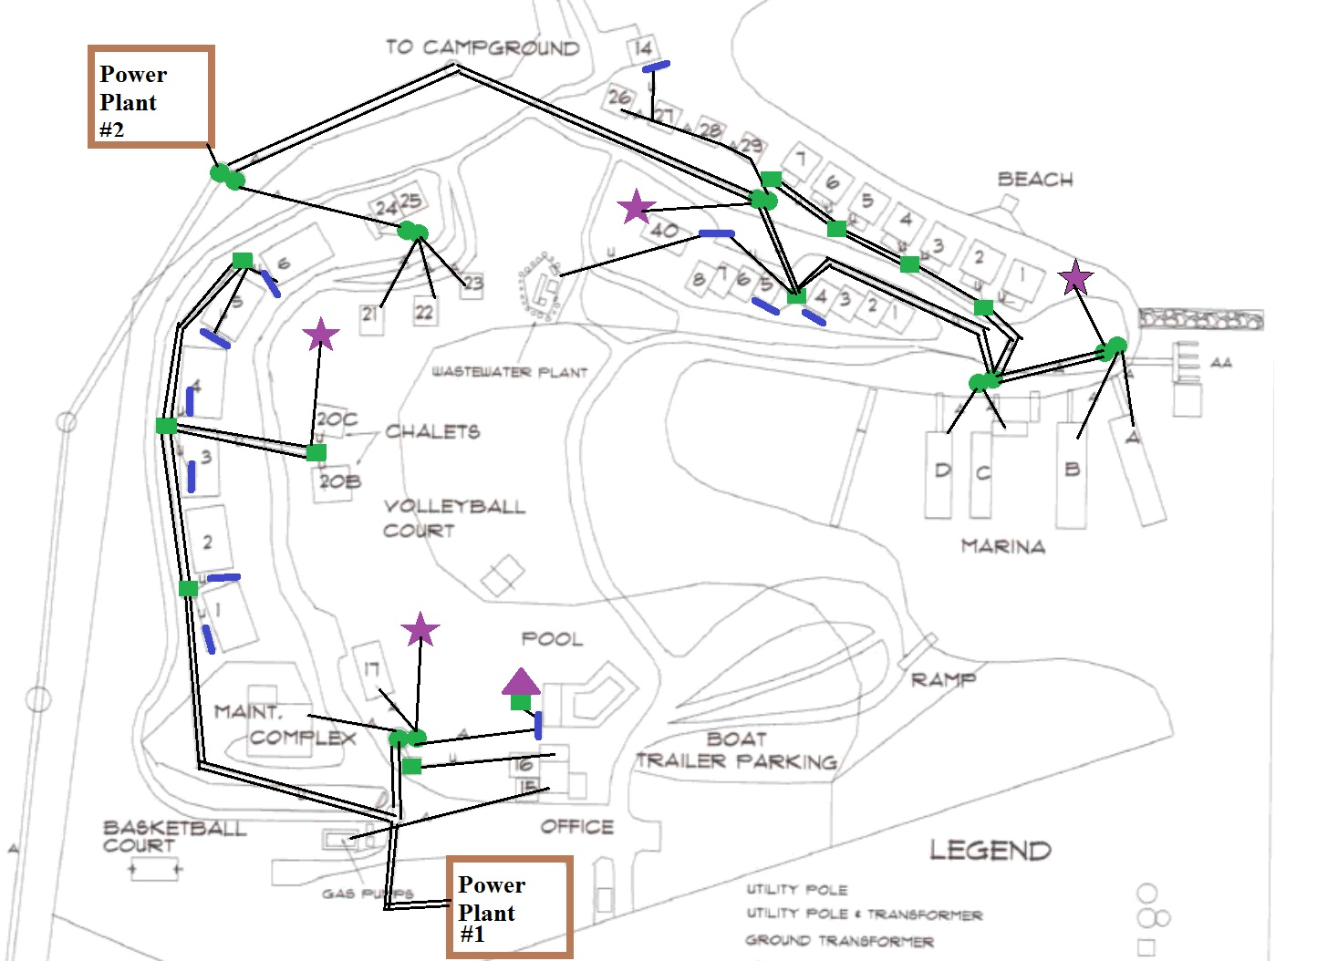
Sample Infrastructure System: Big Bear Resort
Military/Nat. Defense
Industrial
Water/Sewage
Financial
Emergency Services
Government

Slide 8
Sample Infrastructure System: Big Bear Resort
E1
E2
E3
Standard State
Functioning Improperly
Destroyed

Slide 9
Opportunities in EMP Impact Analysis
Failure Mode and Effects Analysis (FMEA/FMECA):
Bottom Up Approach
Fails to Account for Combined Effects Across Infrastructures
Fault Tree Analysis (FTA):
Top Down Approach
Does Not Find All Initiating Faults
Bouncing Failure Analysis (BFA):
Multi-Point Critical Path Approach
Does Not Provide Quantifiable Values

Slide 10
3D Spherical Impact Network Model
Trans
Breaker Box
Trans
Breaker Box
Electric Grid
Infrastructure District
Trans
Critical Infrastructure
Trans
Cost Flow Arc
100%
100%
100%
100%
100%
100%
Government
Telecom
Water
Finance
Agriculture

Slide 11
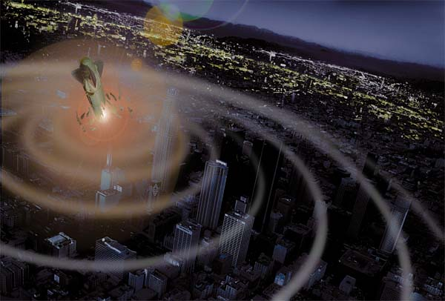
How much Protection Can the United States Get for a Dollar?
Project Analysis Results:
FMEA/FTA Methods:
Failed to show interconnectivity as Stand Alone Methods
Hybrid Approach including Bouncing Failure slightly strengthens analysis
Target Systems Impact Network:
Applicable only if algorithm is reversed
Should be expanded into three dimensions to include all interconnections
Future Objectives:
To analytically rank interconnectivity by Percent Effectiveness, Hardening Cost, and Repair Time
Apply the 3D Impact Network Model to systems
of small surface area and sample size
Notes:
Ex : Hybrid Approach – Hybrid Car analogy
Objectives: How much protection can I get for a dollar?

Slide 12
Questions?

