Slide 1
Methodist Dallas Medical Center
Kyle Chester
Kristin Evanto
Emily Gray
Notes:
Emily

Slide 2
Methodist Dallas Medical Center
“Methodist: Where Life Shines Bright”
Problem Description:
Long lab patient wait times due to:
Patients must fast before their lab tests and rush to hospital in the early morning
Monday and Tuesday mornings experience high wait times due to check-ups after weekend hospital visits
Each doctor sends their patients to lab at a specific time each week
Notes:
Emily

Slide 3
Approach
Objectives:
Assess the entire Outpatient Services process as well as the lab department’s individual role.
Evaluate floor layout for possible redesign (chair arrangement, entrance and exit, etc.).
Investigate staffing in the lab department and determine whether the current staffing level is appropriate.
Observe arrival rates and the general arrival distribution of patients specific to hours within a given day.
Goal: Reduce patient wait times in lab such that 95% of all patients experience wait times less than 15 minutes by identifying the source of the problem (staffing, systems, processes) and suggest alternatives.
Notes:
Emily

Slide 4
Staff
Technician | 7 | 8 |  | 9 | 10 | 11 | 12 | 1 | 2 | 3 |  | 4 | 5
Gwen
Paula
Fatima
April – Director of Access Management
Gennie – Manager of Outpatient Business Services
Gwen – Lab Technician
Veteran employee
Paula – Lab Technician
Newest employee
Fatima – Lab Technician
Part-time employee
Notes:
Kyle

Slide 5
Outpatient Services Overview
Notes:
Kyle:
Flowchart
SpongebobSmith story

Slide 6
Outpatient Services Lab Room
Patients seated in chairs one and two can be serviced immediately.
Notes:
Kyle

Slide 7
Outpatient Services Lab Room
Patients seated in chair three can also be immediately serviced.
Notes:
Kyle

Slide 8
Outpatient Services Lab Room
Patients seated in chairs four and five must continue to wait for service until chairs one, two, or three become available.
Therefore, these chairs represent additional waiting time not captured in MDMC’s current patient time logs.
Notes:
Kyle
Kristin: Blooper story of man waiting in lab room by mistake while he was waiting on wife to get out of colonoscopy

Slide 9
Outpatient Services Lab Room
A lab patient waits while technician Paula manually confirms his lab order in the computer.
Notes:
Kyle

Slide 10
Outpatient Services Lab Room
Computer desk space and label printer
Notes:
Kyle

Slide 11
Outpatient Services Lab Room
EKG test room
Notes:
Kyle

Slide 12
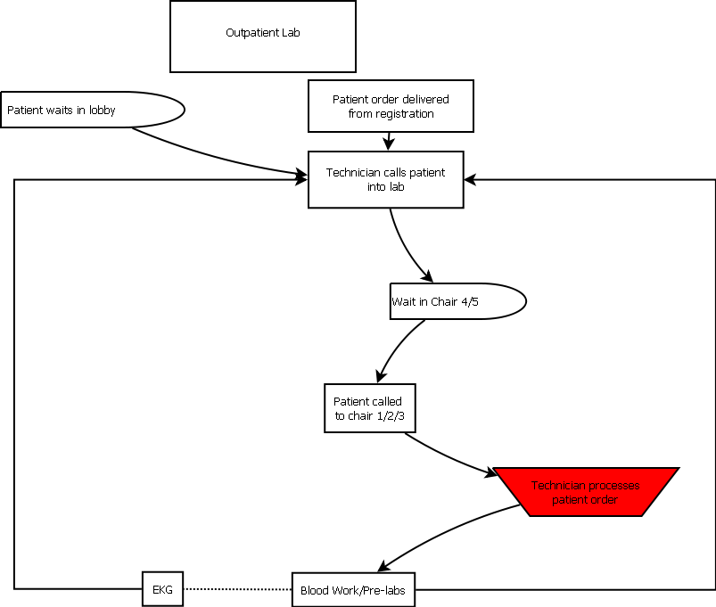
Current Lab Process
Notes:
Kyle:
Flowchart
SpongebobSmith story

Slide 13
Patient Profile
An average of 44 patients are seen by the Outpatient lab per day
The average age of patients seen in Outpatient Registration Lab is 52 years old.
6%
27%
34%
Notes:
Kristin:

Slide 14
Lab Tests
Test | Average Service Time
Urine | N/A
EKG (electrocardiogram) - diagnostic tool that measures and records the electrical activity of the heart | 0:05:42
Blood draw | 0:04:17
Newborn Screening (“heel tap”) – blood draw for infants | 0:09:26
“Stat” tests must be processed immediately
The average “wait time” experienced is 18 minutes*
* This wait time does not include the time patients spend waiting once inside the lab test room.
Notes:
Kristin: Discuss the exact process for each test

Slide 15
Outpatient Services Test Procedures
Blood draws typically require 1 to 5 tubes, but can be up to 25 depending on the procedure.
The number of tubes does not change the service time for blood draws. Instead, the complexity of administrative work is increased.
Notes:
Kristin

Slide 16
Breakdown of Time Allocation in Lab
Notes:
Kyle:
Chart of time allocation

Slide 17
Four Major Task Categories
Notes:
Kyle:
Compare/quantify how they are underestimating wait times

Slide 18
General Observations
All lab patients, regardless of tests to be performed, wait in one queue
Radiology, urine, and “stat” patients have priority and move to the front of the queue
Inventory orders for lab supplies are placed on Tuesdays
The lab room is restocked and prepared for the following day at the end of each work day
Technicians wash their hands after every three patients
Health Hazard: newborn babies are in close quarters with adults with potential major health problems
Notes:
Kristin

Slide 19
Inefficiencies Observed
Administrative prep work on computers (order checking) creates a bottleneck in the process
Technicians leave the room frequently to fix administrative errors
Every patient gets escorted back to lab by a Registration employee
Unpredictable periods of patient arrivals due to walk-in policy
Mornings generally experience the highest volume
Shigeo Shingo’s Wastes observed: Motion, Waiting, and Transportation/Over-Processing
Notes:
Kristin
Over-production
Inventory
Motion
Waiting
Transportation
Over-processing
Rework

Slide 20
Time Spent on Computer Delays Entire Lab
Notes:
Kyle

Slide 21
Inaccuracies in Reporting
Currently the wait time is calculated at 18 minutes
Including the time patient waits in servicing chairs (1, 2, and 3), wait time is underestimated by 27%
Including the time patient waits in servicing chairs and time technician spends on administrative tasks (computer), wait time is underestimated by 43%
Notes:
Kyle

Slide 22
Recommendations
Designate an administrative lab employee whose role is to process and confirm all patient orders prior to calling patients into the lab testing room.
This administrative lab employee will reduce the bottleneck currently experienced because they will be in a focused mindset and will not have to jump between alternating tasks.
Administrative employee will become more efficient in tasks because duties are consistent.
Notes:
Kristin

Slide 23
Proposed Lab Process
Notes:
Kristin

Slide 24
Outpatient Radiology Administrative Desk
Outpatient Radiology services between 70 and 90 patients per day.
This Outpatient Radiology desk currently operates under our recommended process in which lab technicians solely work on administrative order checking.
Furthermore, patients receive additional customer satisfaction by watching technicians process their orders.
Notes:
Kristin:
Discuss general Radiology process and tests performed
Use of Scheduling Department

Slide 25
Recommendations
Registration employees should ask patients if they want to be escorted back to the lab waiting room.
Asking this question provides patients with customer satisfaction and feelings of hospitality; however, it also allows the Registration employee to conserve potentially wasted labor.
Notes:
Kristin

Slide 26
Recommendations
Allow patients to schedule lab appointments, specifically for EKG and Newborn Screening tests.
Allot a percentage of total patients that can schedule daily appointments; however, maintain walk-in procedure for patient convenience
Patient appointments are useful for planning purposes (i.e. Joint Academy)
Outpatient Services can partner with the Scheduling Department to achieve this recommendation
Notes:
Kristin

Slide 27
Patient Scheduling Can Smooth Demand
Notes:
Kristin

Slide 28
Recommendations
Remove lab chairs four and five, which function as a third waiting area
This third waiting area under-represents MDMC’s patient wait time data.
This wait time will be removed with the addition of the administrative lab technician because orders will be processed prior to the patient entering the lab test room. Therefore, patients will be serviced immediately when called.
Notes:
Kristin

Slide 29
Queueing Theory
A Poisson process models random events (such as a customer arrival) as emanating from a memoryless process. That is, the length of the time interval from the current event to the occurrence of the next event does not depend upon the time of occurrence of the last event.
In the Poisson probability distribution, the observer records the number of events that occur in a time interval of fixed length.
Even a queueing model based on the Poisson process that does a relatively poor job of mimicking detailed system performance can be useful because such models often give "worst-case" scenario evaluations. Also, the form of the solution of models based on the Poisson process often provides insight into the form of the solution to a queueing problem whose detailed behavior is poorly mimicked. As a result, queueing models are frequently modeled as Poisson processes through the use of the exponential distribution.
Notes:
Emily

Slide 30
Queueing: M/M/s
Arrival
Distribution = Poisson
Rate = λ = 4.33/hour
Service
Distribution =
Exponential
Current Service Rate
µ = 2.58/hour
Recommended Service Time
= 0:06:58 (weighted average of test times)
Recommended Service Rate = µ = 8.61/hour
s = number of servers
1, 2, or 3 depending on staffing schedule
Notes:
Emily

Slide 31
Queueing (M/M/s): Current and Recommended Systems:
 | Current | Proposed
Number of Servers | 1 | 1 | 2 | 2 | 3 | 3
Utilization = ρ = λ÷µ | 1.678 | 0.503 | 0.839 | 0.251 | 0.559 | 0.168
P(no wait) = 1 - ρ | -0.678 | 0.497 | 0.161 | 0.746 | 0.441 | 0.832
Expected number of patients waiting = Lq | -4.1526 | 0.509 | 2.2602 | 0.104 | 0.5435 | 0.00398
Expected wait time = Wq | -57.54 min | 7.08 min | 31.326 min | 1.44 min | 3.324 min | 0.05 min
P(wait > 15 min) | 4.169x10^(11) | 6.69x10^(-29) | 0.00165 | 2.45x10^(-43) | 2.1649x10^(-8) | 3.62x10^(-48)
Notes:
Emily

Slide 32
Implementation Guidelines for Administrative Lab Employee
Become familiar with Radiology’s administrative process
Speak with Scheduling Department to incorporate lab patients into current scheduling
Establish an administrative lab desk within the waiting area, similar to the Radiology desk
Added patient satisfaction because this employee can also serve as a contact point for agitated lab patients to check on their status
Must communicate that administrative role is not a demotion.
Employees should be rotated daily between administrative position and technician to maintain proficiency in both skills.
Notes:
Emily

Slide 33
Implementation Guidelines for Administrative Lab Employee
No additional training of employees is required since all lab technicians currently use the computers
The employee assigned to administrative work will become proficient in the system due to repeated use
Responsibilities of administrative lab employee:
Confirm patient orders
Print patient labels and prepare patient file
Answer patient questions
Order new inventory
Notes:
Emily

Slide 34
Implementation Guidelines for Administrative Lab Employee
We recommend starting this process with Gwen since she is the most familiar with the computer system; however, all three employees will rotate through this position.
Administrative position is critical during peak times and rush hours and may not be necessary during downtime.
Notes:
Emily

Slide 35
Questions?
Notes:
Emily

